Slide 1
Brain Tumor Classification Using Machine Learning
Prepared by:
Neelmani Shekhar (19105113005)
Neeraj Kumar (19105113013)
Sahil Kumar (20105113908)
Ashish Kumar Lucky (19105113012)
Under the Supervision of Mr. Umesh kumar
Asst. Prof. (Dept. of CSE)
DEPARTMENT OF COMPUTER SCIENCE AND ENGINEERING MOTIHARI COLLEGE OF ENGINEERING MOTIHARI-845401, BIHAR

Slide 2
Outlines
Introduction
Objective
Technology Used
Working
Result analysis
Conclusion
Future Work

Slide 3
Introduction
A Brain Cancer is very critical disease which causes deaths of many individuals. The brain tumor detection and classification system is available so that it can be diagnosed at early stages.
Cancer classification is the most challenging tasks in clinical diagnosis.

Slide 4
Objective
In this machine learning project, we build a classifier to detect the brain tumor (if any) from the MRI (Magnetic resonance imaging) scan images . The performance of model is predict brain tumor is present or not. If the tumor is detected it return yes and some details about tumor, otherwise it return no.

Slide 5
Technology Used
Dataset: Brain Tumor MRI scan images
Python Libraries
Numpy
Tenserflow
CV2
Matplotlib
Sklearn
pandas
Interface
Gradio
Tenserflow
CV2

Slide 6
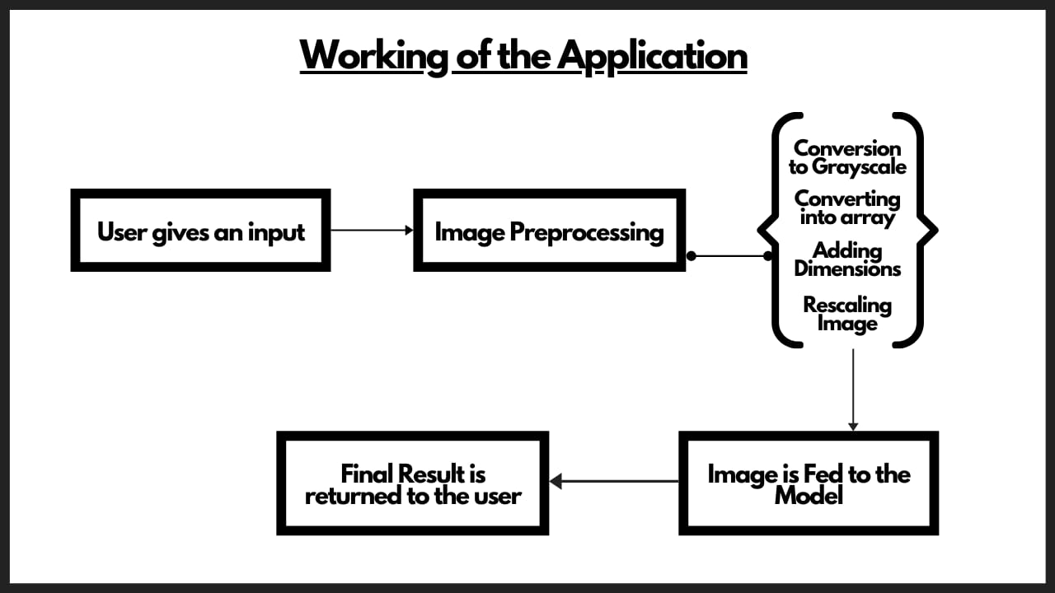

Slide 7
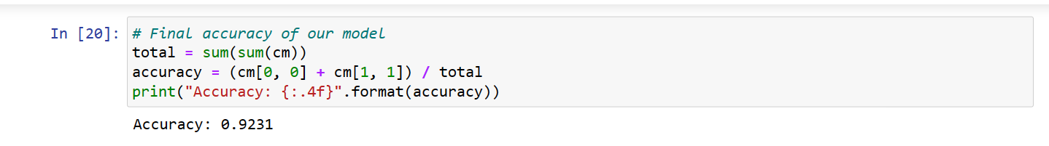
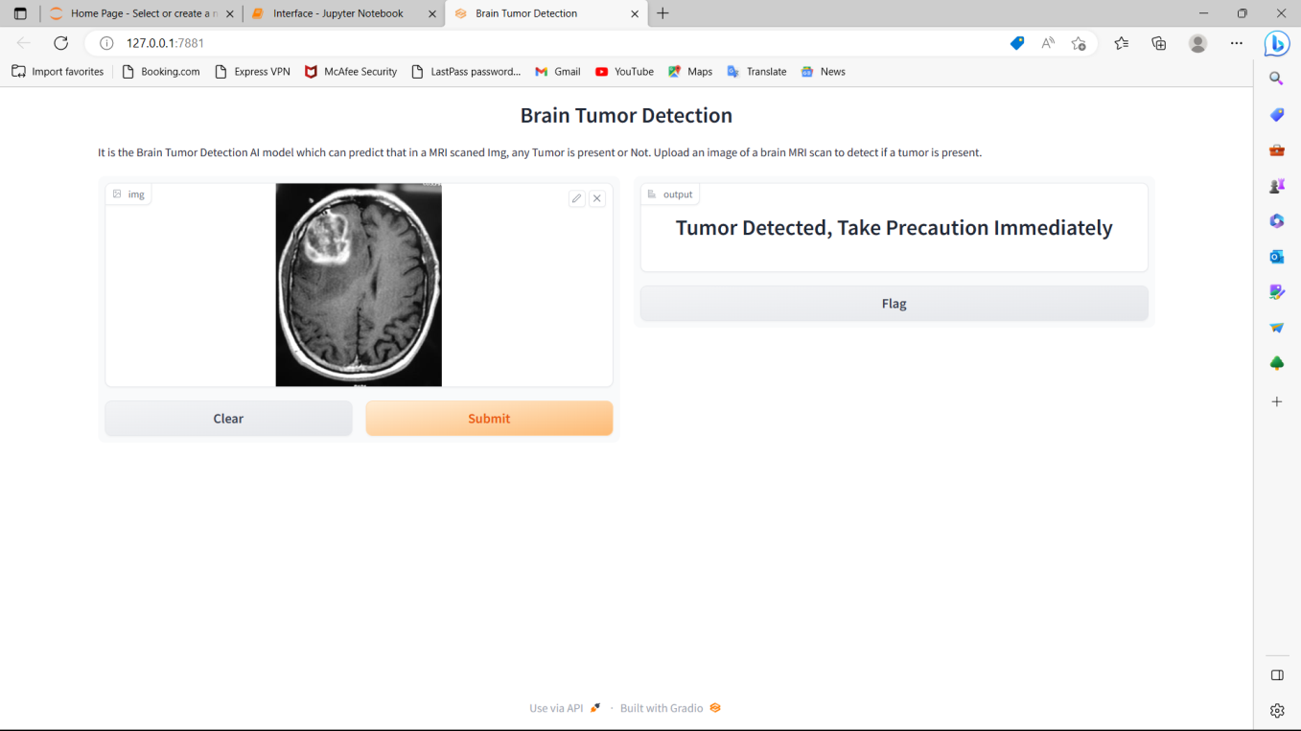
Result Analysis
Accuracy of model :

Slide 8
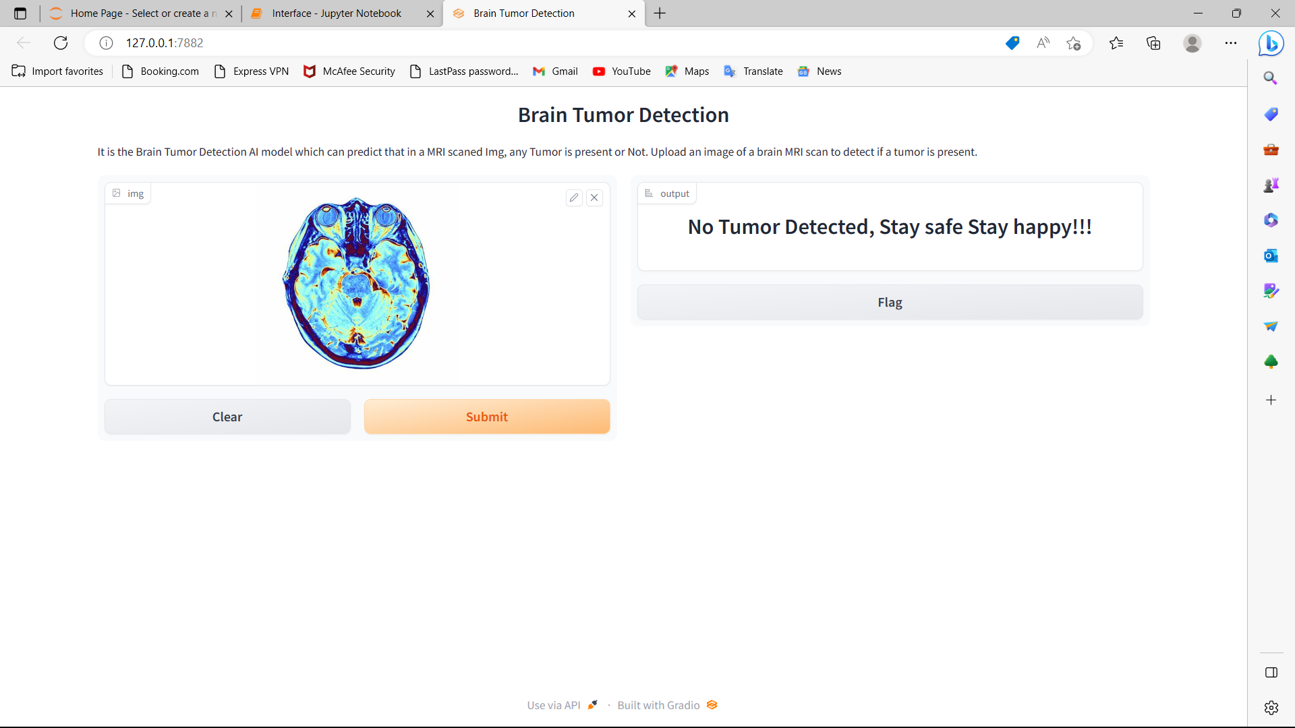

Slide 9
Conclusion
In brain tumor detection we have studied about feature based existing work. In feature based we have study about image processing techniques likes image pre-processing, image segmentation, features extraction, classification. And also study about deep learning techniques MRI(Magnetic resonance imaging).
In this system we have detect the tumor is present or not if the tumour is present then model return’s yes otherwise it return no. and we have compared MRI Images

Slide 10
Future Work
Exploring new types of brain tumor classification.
Improving the accuracy of the models.
Evaluating the models on different datasets.
Integrating imaging techniques.
Developing clinical decision support systems.

Slide 11
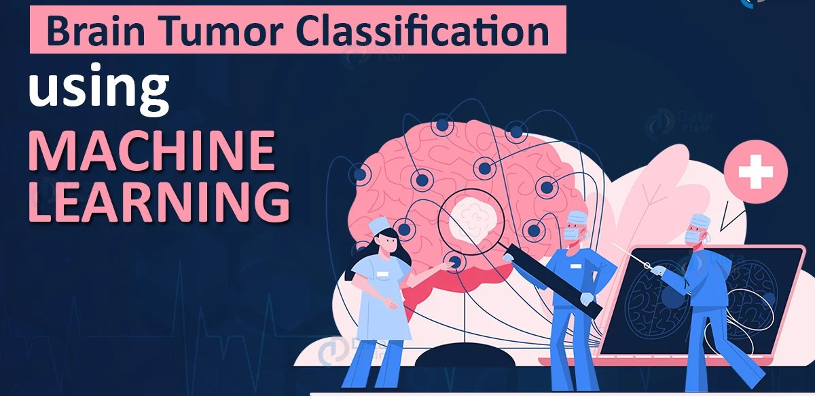
Thank You

